Slide 1
离 散 数 学
--数论和密码学
数论基础、数论算法、密码算法
2024年9月19日星期四

Slide 2
Chapter Summary
Divisibility and Modular Arithmetic
Primes and Greatest Common Divisors
Solving Congruences
Applications of Congruences
Cryptography

Slide 3
Divisibility and Modular Arithmetic

Slide 4
Division
Definition: If a and b are integers with a ≠ 0, then a divides b if there exists an integer c such that b = ac.
When a divides b we say that a is a factor or divisor of b and that b is a multiple of a.
The notation a | b denotes that a divides b.
If a | b, then b/a is an integer.
If a does not divide b, we write a ∤ b.
Example: Determine whether 3 | 7 and whether 3 | 12.

Slide 5
Properties of Divisibility
Theorem 1: Let a, b, and c be integers, where a ≠0.
If a | b and a | c, then a | (b + c);
If a | b, then a | bc for all integers c;
If a | b and b | c, then a | c.
Proof: (i) Suppose a | b and a | c, then it follows that there are integers s and t with b = as and c = at. Hence,
b + c = as + at = a(s + t). Hence, a | (b + c)
Corollary: If a, b, and c be integers, where a ≠0, such that a | b and a | c, then a | mb + nc whenever m and n are integers.

Slide 6
Division Algorithm
When an integer is divided by a positive integer, there is a quotient and a remainder. This is traditionally called the “Division Algorithm,” but is really a theorem.
Division Algorithm: If a is an integer and b a positive integer, then there are unique integers q and r, with 0 ≤ r < b, such that a = bq + r .
b is called the divisor.
a is called the dividend.
q is called the quotient.
r is called the remainder.
Examples:
What are the quotient and remainder when 101 is divided by 11?
Solution: The quotient when 101 is divided by 11 is 9 = 101 div 11, and the remainder is 2 = 101 mod 11.
What are the quotient and remainder when −11 is divided by 3?
Solution: The quotient when −11 is divided by 3 is −4 = −11 div 3, and the remainder is 1 = −11 mod 3.
Definitions of Functions div and mod
q = a div b
r = a mod b

Slide 7
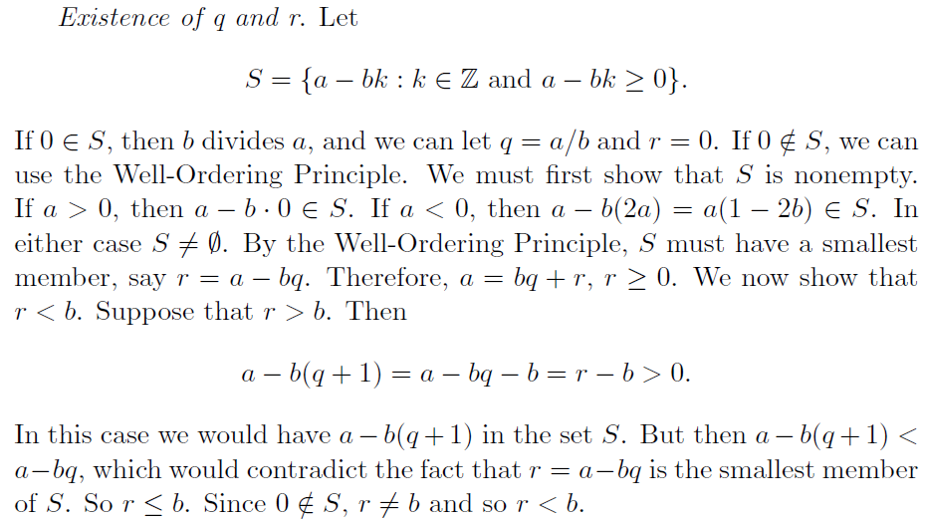
存在性的证明
良序原理(Well-Ordering Principle): 非负整数集合的任意非空子集都有一个最小元素
思考：良序原理和良序有什么联系？
Notes:
模b整数加群中的和a同余数：等价类中元素
最小的元素就是r，对应的k就是q
保证大于0
保证适用良序

Slide 8
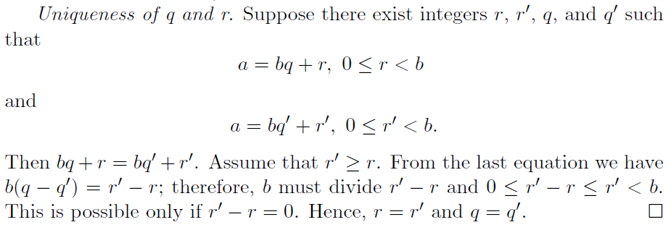
唯一性的证明
Notes:
B是r‘-r的因子，同时b又绝对大于r’-r

Slide 9
Congruence Relation(同余关系)
Definition: If a and b are integers and m is a positive integer, then a is congruent to b modulo m if m divides a − b.
The notation a ≡ b (mod m) says that a is congruent to b modulo m.
We say that a ≡ b (mod m) is a congruence and that m is its modulus.
Two integers are congruent mod m if and only if they have the same remainder when divided by m.
If a is not congruent to b modulo m, we write a ≢ b (mod m)
Example: Determine whether 17 is congruent to 5 modulo 6 and whether 24 and 14 are congruent modulo 6.
Solution:
17 ≡ 5 (mod 6) because 6 divides 17 − 5 = 12.
24 ≢ 14 (mod 6) since 24 − 14 = 10 is not divisible by 6.

Slide 10
More on Congruences
Theorem 4: Let m be a positive integer. The integers a and b are congruent modulo m if and only if there is an integer k such that a = b + km.
Proof:
If a ≡ b (mod m), then (by the definition of congruence) m | a − b. Hence, there is an integer k such that a − b = km and equivalently a = b + km.
Conversely, if there is an integer k such that a = b + km, then km = a − b. Hence, m | a − b and a ≡ b (mod m).
思考：同余关系具有什么性质？

Slide 11
The Relationship between (mod m) and mod m Notations
The use of “mod” in a ≡ b (mod m) and a mod m = b are different.
a ≡ b (mod m) is a relation on the set of integers.
In a mod m = b, the notation mod denotes a function.
The relationship between these notations is made clear in this theorem.
Theorem 3: Let a and b be integers, and let m be a positive integer. Then a ≡ b (mod m) if and only if a mod m = b mod m.

Slide 12
Congruences of Sums and Products
Theorem 5: Let m be a positive integer. If a ≡ b (mod m) and c ≡ d (mod m), then a + c ≡ b + d (mod m) and ac ≡ bd (mod m)
Proof:
Because a ≡ b (mod m) and c ≡ d (mod m), by Theorem 4 there are integers s and t with b = a + sm and d = c + tm.
Therefore,
b + d = (a + sm) + (c + tm) = (a + c) + m(s + t) and
b d = (a + sm) (c + tm) = ac + m(at + cs + stm).
Hence, a + c ≡ b + d (mod m) and ac ≡ bd (mod m).
Example: Because 7 ≡ 2 (mod 5) and 11 ≡ 1 (mod 5) , it follows from Theorem 5 that
18 = 7 + 11 ≡ 2 + 1 = 3 (mod 5)
77 = 7 ∙ 11 ≡ 2 ∙ 1 = 2 (mod 5)

Slide 13
Algebraic Manipulation of Congruences (同余式的代数运算)
Multiplying both sides of a valid congruence by an integer preserves validity.
If a ≡ b (mod m) holds then c∙a ≡ c∙b (mod m), where c is any integer, holds by Theorem 5 with d = c.
Adding an integer to both sides of a valid congruence preserves validity.
If a ≡ b (mod m) holds then c + a ≡ c + b (mod m), where c is any integer, holds by Theorem 5 with d = c.
Dividing a congruence by an integer does not always produce a valid congruence.
Example: The congruence 14≡ 8 (mod 6) holds. But dividing both sides by 2 does not produce a valid congruence since 14/2 = 7 and 8/2 = 4, but 7≢4 (mod 6).

Slide 14
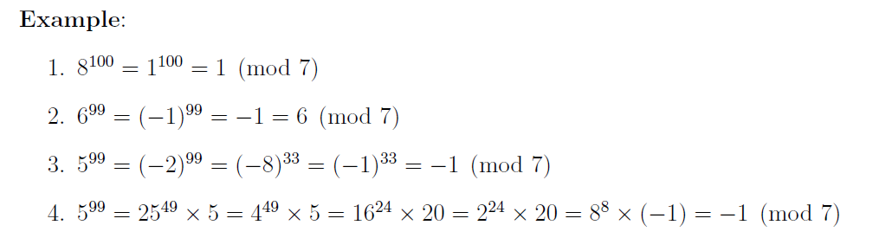
Computing the mod m Function of Products and Sums
Corollary of Theorem 5: Let m be a positive integer and let a and b be integers. Then (a + b) (mod m) = ((a mod m) + (b mod m)) mod m and ab mod m = ((a mod m) (b mod m)) mod m.
思考：如何计算 2⁶⁴⁴ mod 645？

Slide 15
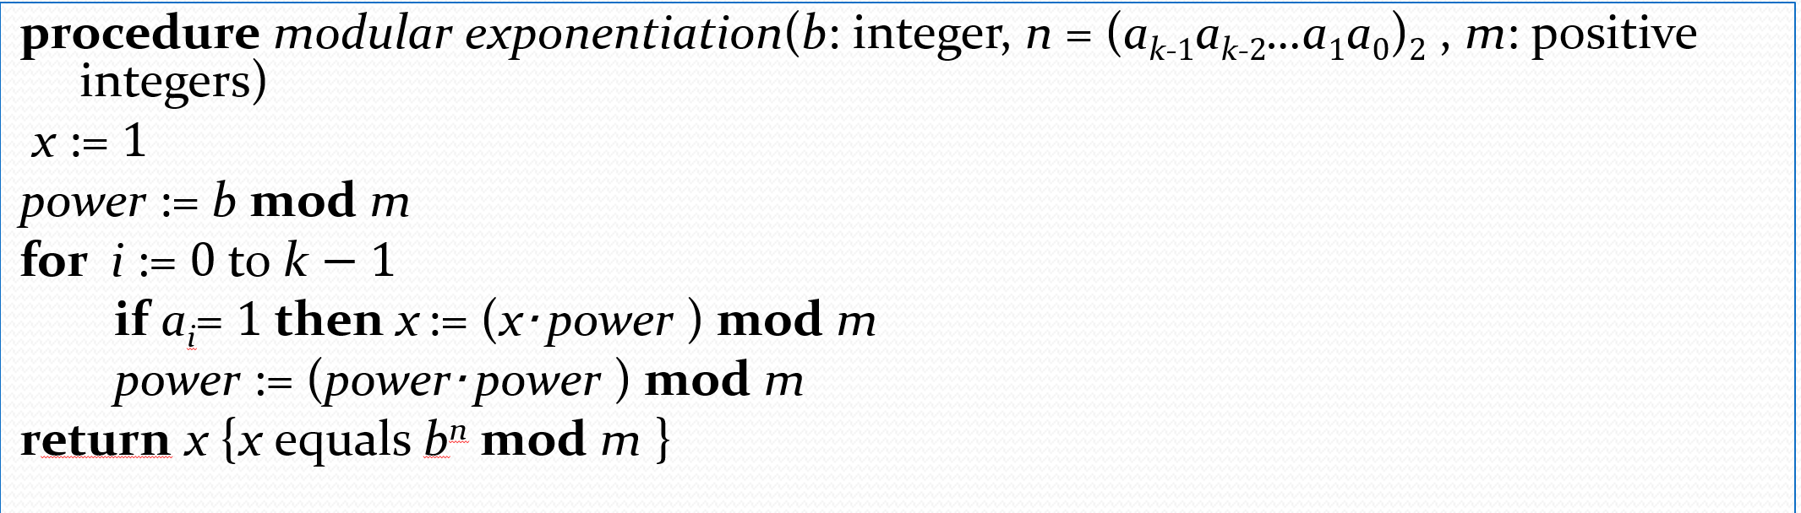
二进制模幂算法
In cryptography, it is important to be able to find b^{n} mod m efficiently
Use the binary expansion of n, n = (a_{k-1},…,a₁,a_{o})₂ , to compute b^{n} .
Note that:
The algorithm successively finds b mod m, b² mod m, b⁴ mod m, …, and multiplies together the terms where a_{j} = 1.
O((log m )² log n) bit operations are used to find b^{n} mod m.

Slide 16
二进制模幂算法
计算 2⁶⁴⁴ mod 645
(644)₁₀= ( 1010000100)₂
2 ≡ 2 (mod 645); 2² ≡ 4 (mod 645); 2⁴ ≡ 16 (mod 645);
2⁸ ≡ 256 (mod 645); 2¹⁶ ≡ 391 (mod 645); 2³² ≡ 16 (mod 645);
2⁶⁴ ≡ 256 (mod 645); 2¹²⁸ ≡ 391 (mod 645); 2²⁵⁶ ≡ 16 (mod 645)
2⁵¹² ≡ 256 (mod 645)
2⁶⁴⁴=2⁵¹²⁺¹²⁸⁺⁴=256*391*16=1601536 ≡ 1 (mod 645)

Slide 17
Groups（群）
A group, G, is a set of elements with an associated binary operation, . It is sometimes denoted {G, }
For each ordered pair (a, b) of elements in G, there is an associated element (a b), such that the following axioms hold:
思考：整数集合Z分别在加法和减法运算下是否构成群？

Slide 18
Groups
A finite group is a group with a finite number of elements, otherwise, a group is an infinite group.
A group is said to be an abelian group if it satisfies the following condition:
Examples of abelian groups:
The set of integers (negative, zero, and positive), Z, under addition. The identity element of Z under addition is 0; the inverse of a is -a, for all a in Z.
The set of non-zero real numbers, R*, under multiplication. The identity element of R* under multiplication is 1; the inverse of a is 1/a for all a in R*.

Slide 19
Exponentiation and Cyclic Groups
Exponentiation within a group is repeated application of the group operator, such that:
A group G is cyclic if every element of G is a power g^{k} (k is an integer) of a fixed element g G. The element g is said to generate the group, or to be a generator of the group.
A cyclic group is always abelian, and may be finite or infinite
Example of a cyclic group:
The group of integers, {Z, +}, under addition is an infinite cyclic group generated by the elements 1 and -1.

Slide 20
Rings（环）
A ring, R, denoted by {R, +, }, is a set of elements with two binary operations, called addition (+) and multiplication ( ), such that, for a, b, c in R:
1)-5) R is an abelian group with respect to addition; for this case of an additive group, we denote the identity element as 0, and the inverse of a as -a.
6) Closure under multiplication:
If a and b belong to R, then a b is also in R
7) Associativity of multiplication:
a (b c) = (a b) c for all a, b, c, in R
8) Distributive Laws:
a (b + c) = a b + a c for all a, b, c, in R
(a + b) c = a c + b c for all a, b, c, in R
addition and multiplication are abstract operations here
Note that we often write a b as simply ab

Slide 21
Commutative Rings（交换环）
A ring is commutative if it satisfies the following additional condition:
9) Commutativity of multiplication:
a b = b a for all a, b, c, in R
Example of a commutative ring:
The set of even integers, {..., -4, -2, 0, 2, 4, ...}) under the normally
defined integer operations of addition and multiplication.

Slide 22
Integral Domains（整环）
An integral domain is a commutative ring that obeys the following:
10) Multiplicative identity:
There is an element 1 in R such that a 1 = 1 a = a for all a in R
11) No zero divisors:
If a, b in R and a b = 0, then either a = 0 or b = 0
Example of an integral domain:
The set of all integers (Z = {..., -3, -2, -1, 0, 1, 2, 3, ...}) under the normally defined integer operations of addition and multiplication, {Z, +, } [整数环]

Slide 23
Fields（域）
A field, F, denoted by {F, +, }, is a set of elements with two binary operations, called addition and multiplication, such that, for all a, b, c in F, the following apply:
1)-11) F is an integral domain
11) Multiplicative inverse:
For each a in F, except 0, there is an element a⁻¹ in F such that:
a a⁻¹ = a⁻¹ a = 1
Again, addition and multiplication are abstract operations

Slide 24
Fields
A field is a set in which we can do addition, subtraction, multiplication, and division without leaving the set.
Division is defined:
a/b = a(b⁻¹)
Examples:
The set of rational numbers, Q; the set of real numbers, R, the set of complex numbers, C.
The set of all integers, Z, is not a field, because only the elements 1 and -1 have multiplicative inverses in the integers.

Slide 25
Groups, Rings, and Fields
Groups
Abelian Groups
Rings
Commutative Rings
Integer Domains
Fields

Slide 26
Arithmetic Modulo m 1
Definitions: Let Z_{m} be the set of nonnegative integers less than m: {0,1, …., m−1}
The operation +_{m} is defined as a +_{m} b = (a + b) mod m. This is addition modulo m.
The operation ∙_{m} is defined as a ∙_{m} b = (a ∙ b) mod m. This is multiplication modulo m.
Using these operations is said to be doing arithmetic modulo m.
Example: Find 7 +₁₁ 9 and 7 ∙₁₁ 9.
Solution: Using the definitions above:
7 +₁₁ 9 = (7 + 9) mod 11 = 16 mod 11 = 5
7 ∙₁₁ 9 = (7 ∙ 9) mod 11 = 63 mod 11 = 8

Slide 27
Arithmetic Modulo m 2
The operations +_{m} and ∙_{m} satisfy many of the same properties as ordinary addition and multiplication.
Closure: If a and b belong to Z_{m} , then a +_{m} b and a ∙_{m} b belong to Z_{m} .
Associativity: If a, b, and c belong to Z_{m} , then (a +_{m} b) +_{m} c = a +_{m} (b +_{m} c) and (a ∙_{m} b) ∙_{m} c = a ∙_{m} (b ∙_{m} c).
Commutativity: If a and b belong to Z_{m} , then a +_{m} b = b +_{m} a and a ∙_{m} b = b ∙_{m} a.
Identity elements: The elements 0 and 1 are identity elements for addition and multiplication modulo m, respectively.
If a belongs to Z_{m} , then a +_{m} 0 = a and a ∙_{m} 1 = a.

Slide 28
Arithmetic Modulo m 3
Additive inverses: If a≠ 0 belongs to Z_{m} , then m− a is the additive inverse of a modulo m and 0 is its own additive inverse.
a +_{m} (m− a ) = 0 and 0 +_{m} 0 = 0
Distributivity: If a, b, and c belong to Z_{m} , then
a ∙_{m} (b +_{m} c) = (a ∙_{m} b) +_{m} (a ∙_{m} c) and (a +_{m} b) ∙_{m} c = (a ∙_{m} c) +_{m} (b ∙_{m} c).
Multiplicatative inverses have not been included since they do not always exist. For example, there is no multiplicative inverse of 2 modulo 6.
Z_{m} with +_{m} is a commutative group and Z_{m} with +_{m} and ∙_{m} is a commutative ring.
思考： Z_{m} with +_{m} and ∙_{m}是整环吗？

Slide 29
Primes and Greatest Common Divisors

Slide 30
Section Summary 3
Prime Numbers and their Properties
Conjectures and Open Problems About Primes
Greatest Common Divisors and Least Common Multiples
The Euclidian Algorithm
gcds as Linear Combinations

Slide 31
Primes
Definition: A positive integer p greater than 1 is called prime if the only positive factors of p are 1 and p. A positive integer that is greater than 1 and is not prime is called composite.
Example: The integer 7 is prime because its only positive factors are 1 and 7, but 9 is composite because it is divisible by 3.

Slide 32
The Fundamental Theorem of Arithmetic (算术基本定理)
Theorem: Every positive integer greater than 1 can be written uniquely as a prime or as the product of two or more primes where the prime factors are written in order of nondecreasing size.
Examples:
100 = 2 ∙ 2 ∙ 5 ∙ 5 = 2² ∙ 5²
641 = 641
999 = 3 ∙ 3 ∙ 3 ∙ 37 = 3³ ∙ 37
1024 = 2 ∙ 2 ∙ 2 ∙ 2 ∙ 2 ∙ 2 ∙ 2 ∙ 2 ∙ 2 ∙ 2 = 2¹⁰

Slide 33
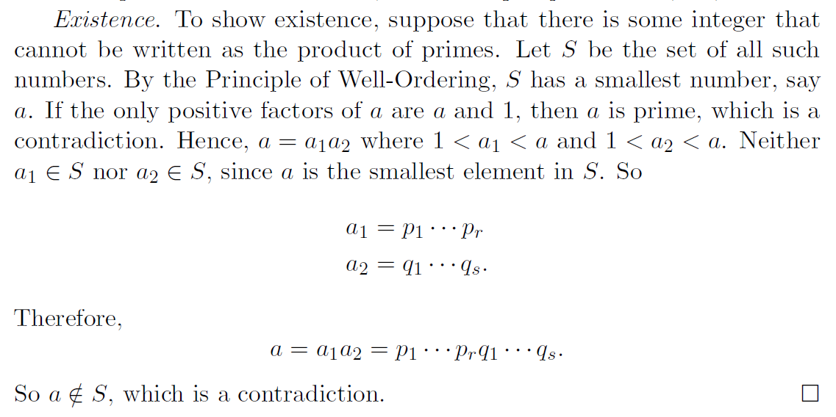
算术基本定理的存在性证明

Slide 34
例题
例1 21560有多少个正因子?
解 21560=2³×5×7²×11
因此 21560的正因子的个数为4×2×3×2=48.
例2 10!的二进制表示中从最低位数起有多少个连续的0?
解 2, 3, 4=2², 5, 6=2×3, 7, 8=2³, 9=3², 10=2×5.
得
10!=2⁸×3⁴×5²×7,
故10!的二进制表示中从最低位数起有8个连续的0.

Slide 35
素数测试
定理 如果a是合数, 则a必有小于等于 的真因子.
证 a=bc, 其中1<b<a, 1<c<a. 显然, b和c中
必有一个小于等于 . 否则, bc>( )²=a, 矛盾.
推论 如果a是合数, 则a必有小于等于 的素因子.
证 由定理, a有小于等于 的真因子b. 如果b是素数,
则结论成立. 如果b是合数, b有
素因子p<b≤ . p也是a 的因子, 结论也成立.

Slide 36

例题
例3 判断157和161是否是素数.
解 , 都小于13, 小于13的素数有: 2, 3, 5, 7, 11.
检查结果如下:
2 157, 3 157, 5 157, 7 157, 11 157
结论: 157是素数.
2 161, 3 161, 5 161, 7|161（161=7×23）
结论：161是合数.

Slide 37
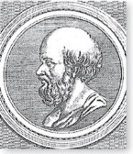
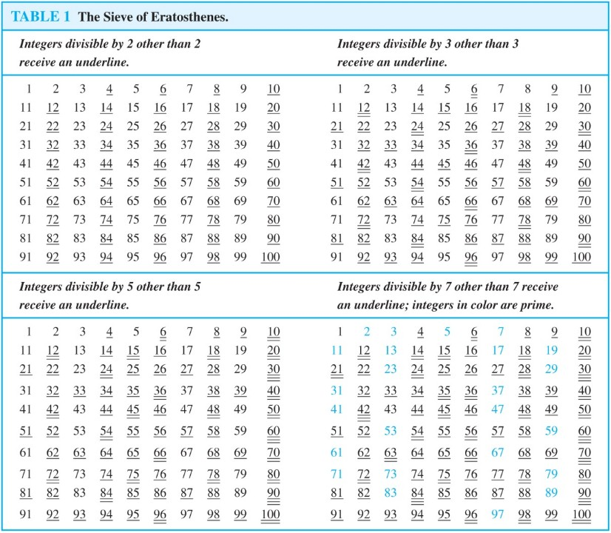
The Sieve of Erastosthenes (埃拉托斯特尼筛法)
Erastothenes
(276-194 B.C.)
If an integer n is a composite integer, then it has a prime divisor less than or equal to √n.
Trial division, a very inefficient method of determining if a number n is prime, is to try every integer i ≤√n and see if n is divisible by i.
思考： 该方法是多项式时间吗？

Slide 38
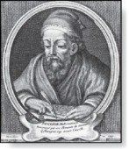
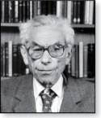
Infinitude of Primes （无穷素数）
Theorem: There are infinitely many primes. (Euclid)
Proof: Assume finitely many primes: p₁, p₂, ….., p_{n}
Let q = p₁p₂∙∙∙ p_{n} + 1
Either q is prime or by the fundamental theorem of arithmetic it is a product of primes.
But none of the primes p_{j} divides q since if p_{j} | q, then p_{j} divides q − p₁p₂∙∙∙ p_{n} = 1 .
Hence, there is a prime not on the list p₁, p₂, ….., p_{n}. It is either q, or if q is composite, it is a prime factor of q. This contradicts the assumption that p₁, p₂, ….., p_{n} are all the primes.
Consequently, there are infinitely many primes.
Euclid
(325 B.C.E. – 265 B.C.E.)
This proof was given by Euclid “The Elements”. The proof is considered to be one of the most beautiful in all mathematics. It is the first proof in “The Book”, inspired by the famous mathematician Paul Erdős’ imagined collection of perfect proofs.
Paul Erdős
(1913-1996)

Slide 39
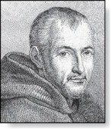
Representing Functions
Definition: Prime numbers of the form 2^{p} − 1 , where p is prime, are called Mersenne primes.
2² − 1 = 3, 2³ − 1 = 7, 2⁵ − 1 = 37 , and 2⁷ − 1 = 127 are Mersenne primes.
2¹¹ − 1 = 2047 is not a Mersenne prime since 2047 = 23∙89.
There is an efficient test for determining if 2^{p} − 1 is prime.
The largest known prime numbers are Mersenne primes.
As of mid 2011, 47 Mersenne primes were known, the largest is 2^{43,112,609} − 1, which has nearly 13 million decimal digits.
The Great Internet Mersenne Prime Search (GIMPS) is a distributed computing project to search for new Mersenne Primes.
http://www.mersenne.org/
当n是合数时, 2^{n}−1一定是合数, 2^{ab}−1=(2ª−1)(2^{a(b−1)}+2^{a(b−2)}+…+2ª+1).
Marin Mersenne
(1588-1648)

Slide 40
Distribution of Primes
Mathematicians have been interested in the distribution of prime numbers among the positive integers. In the nineteenth century, the prime number theorem was proved which gives an asymptotic estimate for the number of primes not exceeding x.
Prime Number Theorem: The ratio of the number of primes not exceeding x and x/ln x approaches 1 as x grows without bound. (ln x is the natural logarithm of x)
The theorem tells us that the number of primes not exceeding x, can be approximated by x/ln x.
The odds that a randomly selected positive integer less than n is prime are approximately (n/ln n)/n = 1/ln n.

Slide 41
Generating Primes
The problem of generating large primes is of both theoretical and practical interest.
We will see that finding large primes with hundreds of digits is important in cryptography.
So far, no useful closed formula that always produces primes has been found. There is no simple function f(n) such that f(n) is prime for all positive integers n.
But f(n) = n² − n + 41 is prime for all integers 1,2,…, 40. Because of this, we might conjecture that f(n) is prime for all positive integers n. But f(41) = 41² is not prime.
More generally, there is no polynomial with integer coefficients such that f(n) is prime for all positive integers n.

Slide 42
Conjectures about Primes (关于素数的猜想)
Even though primes have been studied extensively for centuries, many conjectures about them are unresolved, including:
Goldbach’s Conjecture: Every even integer n, n > 2, is the sum of two primes. It has been verified by computer for all positive even integers up to 1.6 ∙10¹⁸. The conjecture is believed to be true by most mathematicians.
The Twin Prime Conjecture: The twin prime conjecture is that there are infinitely many pairs of twin primes. Twin primes are pairs of primes that differ by 2. Examples are 3 and 5, 5 and 7, 11 and 13, etc. The current world’s record for twin primes (as of mid 2011) consists of numbers 65,516,468,355∙23^{33,333} ±1, which have 100,355 decimal digits.

Slide 43
Greatest Common Divisor 1 (最大公约数)
Definition: Let a and b be integers, not both zero. The largest integer d such that d | a and also d | b is called the greatest common divisor of a and b. The greatest common divisor of a and b is denoted by gcd(a,b).
Example: gcd(24,36)=12 , gcd(17,22)=1
思考：gcd(-24,-36)=? gcd(-17,22)=?

Slide 44
Greatest Common Divisor 2
Definition: The integers a and b are relatively prime if their greatest common divisor is 1.
Example: 17 and 22
Definition: The integers a₁, a₂, …, a_{n} are pairwise relatively prime if gcd(a_{i}, a_{j}) = 1 whenever 1 ≤ i<j ≤n.
Example: Determine whether the integers 10, 17 and 21 are pairwise relatively prime.
Solution: Because gcd(10,17) = 1, gcd(10,21) = 1, and gcd(17,21) = 1, 10, 17, and 21 are pairwise relatively prime.
Example: Determine whether the integers 10, 19, and 24 are pairwise relatively prime.
Solution: Because gcd(10,24) = 2, 10, 19, and 24 are not pairwise relatively prime.

Slide 45
Finding the Greatest Common Divisor Using Prime Factorizations
Suppose the prime factorizations of a and b are:
where each exponent is a nonnegative integer, and where all primes occurring in either prime factorization are included in both. Then:
This formula is valid since the integer on the right (of the equals sign) divides both a and b. No larger integer can divide both a and b.
Example: 120 = 2³ ∙3 ∙5 500 = 2² ∙5³
gcd(120,500) = 2^{min(3,2)} ∙3^{min(1,0)} ∙5^{min(1,3)} = 2² ∙3⁰ ∙5¹ = 20
Finding the gcd of two positive integers using their prime factorizations is not efficient because there is no efficient algorithm for finding the prime factorization of a positive integer.

Slide 46
Least Common Multiple (最小公倍数)
Definition: The least common multiple of the positive integers a and b is the smallest positive integer that is divisible by both a and b. It is denoted by lcm(a,b).
The least common multiple can also be computed from the prime factorizations.
This number is divided by both a and b and no smaller number is divided by a and b.
Example: lcm(2³3⁵7², 2⁴3³) = 2^{max(3,4)} 3^{max(5,3)} 7^{max(2,0)} = 2⁴ 3⁵ 7²
The greatest common divisor and the least common multiple of two integers are related by:
Theorem 5: Let a and b be positive integers. Then
ab = gcd(a,b) ∙lcm(a,b)

Slide 47
Euclidean Algorithm 1 (欧几里得算法)
The Euclidian algorithm is an efficient method for computing the greatest common divisor of two integers. It is based on the idea that gcd(a,b) is equal to gcd(b,c) when a > b and c is the remainder when a is divided by b.
Example: Find gcd(91, 287):
287 = 91 ∙ 3 + 14
91 = 14 ∙ 6 + 7
14 = 7 ∙ 2 + 0
Euclid
(325 B.C.E. – 265 B.C.E.)
Divide 287 by 91
Divide 91 by 14
Divide 14 by 7
Stopping condition
gcd(287, 91) = gcd(91, 14) = gcd(14, 7) = 7

Slide 48
Euclidean Algorithm 2
The Euclidean algorithm expressed in pseudocode is:
procedure gcd(a, b: positive integers)
x := a y := b
while y ≠ 0
r := x mod y
x := y
y := r
return x {gcd(a,b) is x}
思考：如何分析该算法复杂度 ？
每两次递归后 a,b值均降到原来一半以下(r=a-qb<=a-b;另r<b，得2r<a)，其中一个先降到0就停止；因此复杂度为O (log b), 其中 a > b

Slide 49
Correctness of Euclidean Algorithm 1
Lemma 1: Let a = bq + r, where a, b, q, and r are integers. Then gcd(a,b) = gcd(b,r).
Proof:
Suppose that d divides both a and b. Then d also divides a − bq = r. Hence, any common divisor of a and b must also be any common divisor of b and r.
Suppose that d divides both b and r. Then d also divides bq + r = a. Hence, any common divisor of b and r must also be a common divisor of a and b.
Therefore, gcd(a,b) = gcd(b,r).

Slide 50
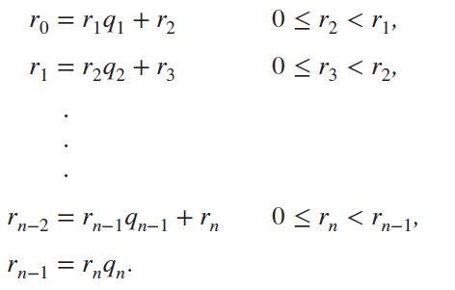
Correctness of Euclidean Algorithm 2
Suppose that a and b are positive
integers with a ≥ b.
Let r₀ = a and r₁ = b.
Successive applications of the division
algorithm yields:
Eventually, a remainder of zero occurs in the sequence of terms: a = r₀ > r₁ > r₂ > ∙ ∙ ∙ ≥ 0. The sequence can’t contain more than a terms.
By Lemma 1
gcd(a,b) = gcd(r₀,r₁) = ∙ ∙ ∙ = gcd(r_{n-1},r_{n}) = gcd(r_{n} , 0) = r_{n}.
Hence the greatest common divisor is the last nonzero remainder in the sequence of divisions.

Slide 51
gcds as Linear Combinations
Theorem: If a and b are any integers, not both zero, then gcd(a,b) is the smallest positive element of the set {ax + by : x, y ∈ ℤ} of linear combinations of a and b.
Proof:
Let s be the smallest positive such linear combination of a and b.
Let q be the quotient of a over s. Then a mod s=a-qs=a-q(ax+by)=a(1-qx)+b(-qy).
So a mod s is a linear combination of a and b.
Because s is the smallest positive of the linear combinations and 0<=a mod s <s，
a mod s cannot be positive. Hence a mod s=0.
Then s|a, similarly s|b. Thus s is a common divisor of a and b, gcd(a,b)>=s.
Since gcd(a,b) divides both a and b, and s is a linear combination of a and b, we have gcd(a,b) | s. But gcd(a,b) | s and s>0 imply that gcd(a,b)<=s.
Corollary: For integers a and b, if d |a and d|b, then d|gcd(a,b).

Slide 52
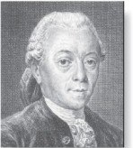
gcds as Linear Combinations
Bézout’s Theorem (贝祖定理): If a and b are
positive integers, then there exist integers
s and t such that gcd(a,b) = sa + tb.
Definition: If a and b are positive integers, then integers s and t such that gcd(a,b) = sa + tb are called Bézout coefficients of a and b.
By Bézout’s Theorem, the gcd of integers a and b can be expressed in the form sa + tb where s and t are integers. This is a linear combination with integer coefficients of a and b.
gcd(6,14) = (−2)∙6 + 1∙14
Étienne Bézout
(1730-1783)

Slide 53
算术基本定理的唯一性证明
Lemma 1: 如果a,b,c为正整数，gcd(a,b)=1且 a|bc，则a|c .
Proof：ax+by=1, 两边同乘c，acx+bcy=c，则a|c.
Lemma 2: 如果质数p|a₁a₂• • • a_{n}，其中a₁,• • • ,a_{n}都为正整数， 则p|a_{i} . [对某个a_{i}成立]
Proof: 归纳法 n=1，显然成立；设对n成立，证对n+1也成立，即证
如果p|a₁a₂• • • a_{n} a_{n+1} ，则p| a_{i} ；(1)如果gcd(p, a₁a₂• • • a_{n})=1,则p|a_{n+1} ；
(2)如果gcd(p, a₁a₂• • • a_{n})=p,即p|a₁a₂• • • a_{n}，则p|a_{i} ，得证.
证明：反证法
n= p₁p₂• • • p_{s}= q₁q₂• • • q_{t} ， p_{i}和q_{j}均为质数且各自都是非降序排列；
再把中间相同的公因子去除，使得 p_{i1}p_{i2}• • • p_{iu}= q_{j1}q_{j2}• • • q_{jv} ，根据上述Lemma 2，p_{i1} |q_{jk} ，因为都为质数且不相同，导致不可能，得证。

Slide 54
求贝祖系数
Example: Express gcd(252,198) = 18 as a linear combination of 252 and 198.
Solution: First use the Euclidean algorithm to show gcd(252,198) = 18
252 = 1∙198 + 54
198 = 3 ∙54 + 36
54 = 1 ∙36 + 18
36 = 2 ∙18
Now working backwards, from iii and i above
18 = 54 − 1 ∙36
36 = 198 − 3 ∙54
Substituting the 2nd equation into the 1st yields:
18 = 54 − 1 ∙(198 − 3 ∙54 )= 4 ∙54 − 1 ∙198
Substituting 54 = 252 − 1 ∙198 (from i)) yields:
18 = 4 ∙(252 − 1 ∙198) − 1 ∙198 = 4 ∙252 − 5 ∙198
This method illustrated above is a two pass method. It first uses the Euclidian algorithm to find the gcd and then works backwards to express the gcd as a linear combination of the original two integers. There’s a one pass method, the extended Euclidean algorithm (扩展欧几里得算法).

Slide 55
思考： “扩展”Euclid算法，扩展了什么？怎么实现的？这个扩展的结果用处是什么？
Notes:
将a，b的线性组合的系数也输出了。两个算法的复杂性是一致的，目的是为后期的模运算服务
一定要用递归的思维方式去理解这个扩充的原理：(d’,x’,y’)构成(b,amodb)的最小线性组合及参数，然后需要从（d’,x’,y’）出发，计算出a,b的最小线性组合及其参数
d=d’;
d=ax+by;
d’=bx’+(a mod b)y’=bx’+(a-b[a/b])y’=ay’+b(x’-[a/b]y’)
因此可以取：x=y’和y=x’-[a/b]y’
线性组合的系数可以用于在剩余乘群中元素的逆元素的计算：ax=b(mod(n)): x

Slide 56
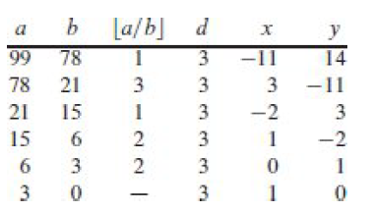
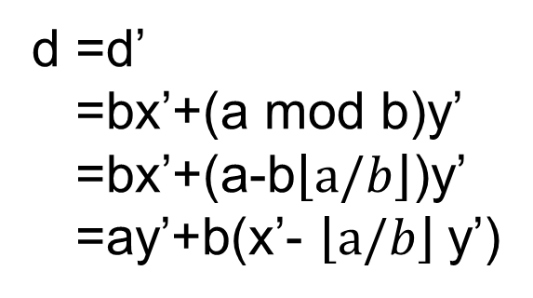
这三个值分别代表什么？
d =d’
=bx’+(a mod b)y’
=bx’+(a-b$\left\lfloor a/b\right\rfloor$)y’
=ay’+b(x’- $\left\lfloor a/b\right\rfloor$y’)
直接返回d’,x’,y’？
Notes:
d和d’是相同的

Slide 57
Dividing Congruences by an Integer
Dividing both sides of a valid congruence by an integer does not always produce a valid congruence.
But dividing by an integer relatively prime to the modulus does produce a valid congruence:
Theorem : Let m be a positive integer and let a, b, and c be integers. If ac ≡ bc (mod m) and gcd(c,m) = 1, then a ≡ b (mod m).
Proof: Since ac ≡ bc (mod m), m | ac − bc = c(a − b) and the fact that gcd(c,m) = 1, it follows that m | a − b. Hence, a ≡ b (mod m).

Slide 58
Solving Congruences

Slide 59
Section Summary 4
Linear Congruences
The Chinese Remainder Theorem
Fermat’s Little Theorem
Pseudoprimes
Primitive Roots and Discrete Logarithms

Slide 60
Linear Congruences
Definition: A congruence of the form
ax ≡ b( mod m),
where m is a positive integer, a and b are integers, and x is a variable, is called a linear congruence.
The solutions to a linear congruence ax ≡ b( mod m) are all integers x that satisfy the congruence.
Definition: An integer ā such that āa ≡ 1( mod m) is said to be an inverse of a modulo m.
Example: 5 is an inverse of 3 modulo 7 since 5∙3 = 15 ≡ 1(mod 7)
One method of solving linear congruences makes use of an inverse ā, if it exists. Although we cannot divide both sides of the congruence by a, we can multiply by ā to solve for x.

Slide 61
Inverse of a modulo m
The following theorem guarantees that an inverse of a modulo m exists whenever a and m are relatively prime. Two integers a and b are relatively prime when gcd(a,b) = 1.
Theorem 1: If a and m are relatively prime integers and m > 1, then an inverse of a modulo m exists. Furthermore, this inverse is unique modulo m. (This means that there is a unique positive integer ā less than m that is an inverse of a modulo m and every other inverse of a modulo m is congruent to ā modulo m.)
Proof: Since gcd(a,m) = 1, there are integers s and t such that
sa + tm = 1.
Hence, sa + tm ≡ 1 ( mod m).
Since tm ≡ 0 ( mod m), it follows that sa ≡ 1 ( mod m)
Consequently, s is an inverse of a modulo m.
The uniqueness of the inverse can also be proved.

Slide 62
Finding Inverses 1
The Euclidean algorithm and Bézout coefficients gives us a systematic approaches to finding inverses.
Example: Find an inverse of 3 modulo 7.
Solution: Because gcd(3,7) = 1, by Theorem 1, an inverse of 3 modulo 7 exists.
Using the Euclidian algorithm: 7 = 2∙3 + 1.
From this equation, we get −2∙3 + 1∙7 = 1, and see that −2 and 1 are Bézout coefficients of 3 and 7.
Hence, −2 is an inverse of 3 modulo 7.
Also every integer congruent to −2 modulo 7 is an inverse of 3 modulo 7, i.e., 5, −9, 12, etc.

Slide 63
Finding Inverses 2
Example: Find an inverse of 101 modulo 4620.
Solution: First use the Euclidian algorithm to show that gcd(101,4620) = 1.
4620 = 45∙101 + 75
101 = 1∙75 + 26
75 = 2∙26 + 23
26 = 1∙23 + 3
23 = 7∙3 + 2
3 = 1∙2 + 1
2 = 2∙1
Working Backwards:
1 = 3 − 1∙2
1 = 3 − 1∙(23 − 7∙3) = − 1 ∙23 + 8∙3
1 = −1∙23 + 8∙(26 − 1∙23) = 8∙26 − 9 ∙23
1 = 8∙26 − 9 ∙(75 − 2∙26 )= 26∙26 − 9 ∙75
1 = 26∙(101 − 1∙75) − 9 ∙75
= 26∙101 − 35 ∙75
1 = 26∙101 − 35 ∙(4620 − 45∙101)
= − 35 ∙4620 + 1601∙101
Since the last nonzero remainder is 1, gcd(101,4620) = 1
Bézout coefficients : − 35 and 1601
1601 is an inverse of 101 modulo 4620

Slide 64
Using Inverses to Solve Congruences
We can solve the congruence ax≡ b( mod m) by multiplying both sides by ā.
Example: What are the solutions of the congruence 3x≡ 4( mod 7).
Solution: We found that −2 is an inverse of 3 modulo 7 (two slides back). We multiply both sides of the congruence by −2 giving
−2 ∙ 3x ≡ −2 ∙ 4(mod 7).
Because −6 ≡ 1 (mod 7) and −8 ≡ 6 (mod 7), it follows that if x is a solution, then x ≡ −8 ≡ 6 (mod 7)
We need to determine if every x with x ≡ 6 (mod 7) is a solution. Assume that x ≡ 6 (mod 7). We can verify that 3x ≡ 3 ∙ 6 = 18 ≡ 4( mod 7) which shows that all such x satisfy the congruence.
The solutions are the integers x such that x ≡ 6 (mod 7), namely, 6,13,20 … and −1, − 8, − 15,…

Slide 65
The Chinese Remainder Theorem 1
In the first century, the Chinese mathematician Sun-Tsu asked:
There are certain things whose number is unknown. When divided by 3, the remainder is 2; when divided by 5, the remainder is 3; when divided by 7, the remainder is 2. What will be the number of things?
This puzzle can be translated into the solution of the system of congruences:
x ≡ 2 ( mod 3),
x ≡ 3 ( mod 5),
x ≡ 2 ( mod 7)?
We’ll see how the theorem that is known as the Chinese Remainder Theorem can be used to solve Sun-Tsu’s problem.

Slide 66
The Chinese Remainder Theorem 2
Theorem 2: (The Chinese Remainder Theorem) Let m₁,m₂,…,m_{n} be pairwise relatively prime positive integers greater than one and a₁,a₂,…,a_{n} arbitrary integers. Then the system
x ≡ a₁ ( mod m₁)
x ≡ a₂ ( mod m₂)
∙
∙
∙
x ≡ a_{n} ( mod m_{n})
has a unique solution modulo m = m₁m₂ ∙ ∙ ∙ m_{n}.
(That is, there is a solution x with 0 ≤ x <m and all other solutions are congruent modulo m to this solution.)
Proof: We’ll show that a solution exists by describing a way to construct the solution.

Slide 67
The Chinese Remainder Theorem 3
To construct a solution first let M_{k}=m/m_{k} for k = 1,2,…,n and m = m₁m₂ ∙ ∙ ∙ m_{n}.
Since gcd(m_{k} ,M_{k} ) = 1, by Theorem 1, there is an integer y_{k} , an inverse of M_{k} modulo m_{k}, such that
M_{k} y_{k} ≡ 1 ( mod m_{k} ).
Form the sum
x = a₁ M₁ y₁ + a₂ M₂ y₂ + ∙ ∙ ∙ + a_{n} M_{n} y_{n} .
Note that because M_{j} ≡ 0 ( mod m_{k}) whenever j ≠k , all terms except the kth term in this sum are congruent to 0 modulo m_{k} .
Because M_{k} y_{k} ≡ 1 ( mod m_{k} ), we see that x ≡ a_{k} M_{k} y_{k} ≡ a_{k}( mod m_{k}), for k = 1,2,…,n.
Hence, x is a simultaneous solution to the n congruences.
x ≡ a₁ ( mod m₁)
x ≡ a₂ ( mod m₂)
∙
∙
∙
x ≡ a_{n} ( mod m_{n})

Slide 68
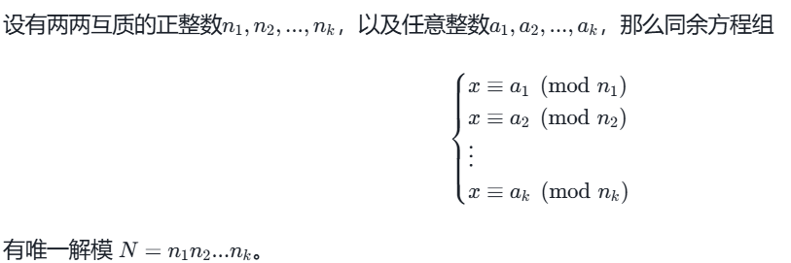
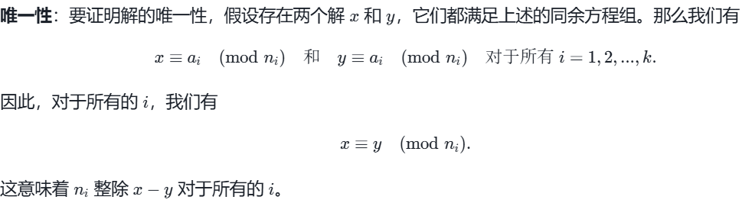
中国剩余定理解的唯一性证明
由于n₁,n₂…和n_{k}两两互质,且n₁|(x-y),n₂|(x-y)…,n_{k}|(x-y)，可证明N=(n₁*n₂*..*n_{k}) | (x-y) ;
[譬如当k=2时，(x-y)=k₁n₁=k₂n₂,可推出 n₁ | k₂n₂,可得 n₁|k₂,则k₂=m₁*n₁,可得(x-y)=m₁n₁n₂,得证; ]
既然 N∣(x−y)，这意味着 x≡y (mod N)。因此，任何两个解 x 和 y 在模 N 下都是相同的，这证明了解的唯一性。

Slide 69
The Chinese Remainder Theorem 4
Example: Consider the 3 congruences from Sun-Tsu’s problem:
x ≡ 2 ( mod 3), x ≡ 3 ( mod 5), x ≡ 2 ( mod 7).
Let m = 3∙ 5 ∙ 7 = 105, M1 = m/3 = 35, M3 = m/5 = 21, M3 = m/7 = 15.
We see that
2 is an inverse of M1 = 35 modulo 3 since 35 ∙ 2 ≡ 2 ∙ 2 ≡ 1 (mod 3)
1 is an inverse of M2 = 21 modulo 5 since 21 ≡ 1 (mod 5)
1 is an inverse of M3 = 15 modulo 7 since 15 ≡ 1 (mod 7)
Hence, x = a1M1y1 + a2M2y2 + a3M3y3 = 2 ∙ 35 ∙ 2 + 3 ∙ 21 ∙ 1 + 2 ∙ 15 ∙ 1 = 233 ≡ 23 (mod 105)
We have shown that 23 is the smallest positive integer that is a simultaneous solution. Check it!

Slide 70
Back Substitution
We can also solve systems of linear congruences with pairwise relatively prime moduli by rewriting a congruences as an equality, substituting the value for the variable into another congruence, and continuing the process until we have worked through all the congruences. This method is known as back substitution.
Example: Use the method of back substitution to find all integers x such that x ≡ 1 (mod 5), x ≡ 2 (mod 6), and x ≡ 3 (mod 7).
Solution: The first congruence can be rewritten as x = 5t +1, where t is an integer.
Substituting into the second congruence yields 5t +1 ≡ 2 (mod 6).
Solving this tells us that t ≡ 5 (mod 6).
Using Theorem 4 again gives t = 6u + 5 where u is an integer.
Substituting this back into x = 5t +1, gives x = 5(6u + 5) +1 = 30u + 26.
Inserting this into the third equation gives 30u + 26 ≡ 3 (mod 7).
Solving this congruence tells us that u ≡ 6 (mod 7).
By Theorem 4, u = 7v + 6, where v is an integer.
Substituting this expression for u into x = 30u + 26, tells us that x = 30(7v + 6) + 26 = 210u + 206.
Translating this back into a congruence we find the solution x ≡ 206 (mod 210).

Slide 71
Wilson定理
Wilson定理：P是质数当且仅当 (p-1)! ≡ -1( mod p).
引理: 如p为质数且 x² ≡ 1 (mod p)，则x ≡ 1 (mod p)或 x ≡ -1 (mod p).
引理证明: p | (x² -1),即 p|(x+1)(x-1),因p为质数,则 p|(x+1)或 p|(x-1)，得证。
Wilson定理证明：先证当(p-1)! ≡ -1( mod p),则p为质数：
设n|p且n≠p，则n∈{1,2,…,p-1}，能推导出 n|(p-1)!；根据条件，
p| ((p-1)!+1)，因为n | p,则 推出 n | ((p-1)!+1)；又已推出 n|(p-1)!,得n|1，则n=1，推出p的因子只有p和1，则p为质数.
再证当p为质数，则(p-1)! ≡ -1( mod p)：[设p≥5, p=2,3时易证]
引例：6! (mod 7)=1*(2*4)*(3*5)*6 (mod 7)= 6 (mod 7)= -1 (mod 7);
对集合{2,3,…,p-2}中任一数a，根据上述引理可知a²≢ 1 (mod p),所以其中每个数a都有唯一的不等于a的模p逆 a⁻¹,且如a≠b，a ⁻¹≠ b⁻¹;
(p-1)!=1*(p-1)*(2*3*…*(p-2))=(p-1)*((p-3)/2对互逆的数相乘)(mod p)=(p-1) (mod p)=-1 (mod p), 得证.

Slide 72
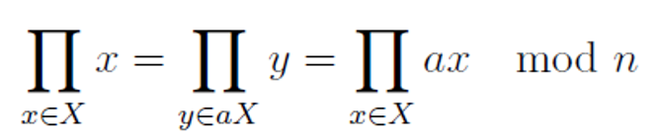
欧拉函数与欧拉定理
欧拉函数φ(n)：比n小且与n互质的正整数的个数.
例：φ(6)=2 [1,5]; φ(7)=6 [1,2,3,4,5,6]
欧拉函数φ(n)的计算： 如果p是质数，则φ(p)=p-1. 如果n=pq，且p和q是两个不同的质数，则φ(n)=(p-1)(q-1).
欧拉定理：如果 gcd(a,n)=1，则a^{φ(n)} ≡ 1 (mod n).
证明：设X={x | x为小于n的正整数且gcd(x,n)=1}， 则 |X|=φ(n);
对元素a且gcd(a,n)=1,有集合aX={ax mod n| x∈X};
因为gcd(a,n)=gcd(x,n)=1,可知gcd(ax,n)=1; 再看aX集合中任意两个元素
ax_{i} ≡ ax_{j} (mod n)是否成立；如成立，则推出n|(x_{i}-x_{j}),即x_{i}=x_{j}；
因此aX=X,即两个集合相等;
将集合X和集合aX中所有元素相乘，得：
再将以上等式两边都乘x mod n的逆，等式最左边为1，等式最右边为a^{φ(n)} ,
因此a^{φ(n)} ≡ 1 (mod n), 得证.

Slide 73
欧拉定理推论
欧拉定理推论：如果 gcd(a,n)=1，则a^{x} ≡ a^{x (mod φ(n))} (mod n).
证明：x=q*φ(n)+r, r= x mod φ(n),
则 a^{x} = a^{qφ(n)+r} =a^{r} =a^{x (mod φ(n))} (mod n).
欧拉定理推论应用：
2⁹⁹⁹ mod 21=?
因n=21=3*7，则φ(21)=2*6=12, 又因为gcd(2,21)=1,
则2⁹⁹⁹ mod 21=2^{999 mod 12}=2³=8 (mod 21)
在RSA公钥密码算法正确性证明中也会用到上述推论.

Slide 74
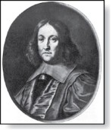
Fermat’s Little Theorem
Theorem 3: (Fermat’s Little Theorem) If p is prime and a is an integer not divisible by p, then a^{p-1} ≡ 1 (mod p)
Furthermore, for every integer a we have a^{p} ≡ a (mod p)
Fermat’s little theorem is useful in computing the remainders modulo p of large powers of integers.
Example: Find 7²²² mod 11.
By Fermat’s little theorem, we know that 7¹⁰ ≡ 1 (mod 11), and so (7¹⁰ )^{k} ≡ 1 (mod 11), for every positive integer k. Therefore,
7²²² = 7^{22∙10 + 2} = (7¹⁰)²²7² ≡ (1)²² ∙49 ≡ 5 (mod 11).
Hence, 7²²² mod 11 = 5.
Pierre de Fermat
(1601-1665)

Slide 75
Pseudoprimes 1
By Fermat’s little theorem n > 2 is prime, where
2^{n-1} ≡ 1 (mod n).
But if this congruence holds, n may not be prime. Composite integers n such that 2^{n-1} ≡ 1 (mod n) are called pseudoprimes to the base 2.
Example: The integer 341 is a pseudoprime to the base 2.
341 = 11 ∙ 31
2³⁴⁰ ≡ 1 (mod 341)
We can replace 2 by any integer b ≥ 2.
Definition: Let b be a positive integer. If n is a composite integer, and b^{n-1} ≡ 1 (mod n), then n is called a pseudoprime to the base b.

Slide 76
Pseudoprimes 2
Given a positive integer n, such that 2^{n-1} ≡ 1 (mod n):
If n does not satisfy the congruence, it is composite.
If n does satisfy the congruence, it is either prime or a pseudoprime to the base 2.
Doing similar tests with additional bases b, provides more evidence as to whether n is prime.
Among the positive integers not exceeding a positive real number x, compared to primes, there are relatively few pseudoprimes to the base b.
For example, among the positive integers less than 10¹⁰ there are 455,052,512 primes, but only 14,884 pseudoprimes to the base 2.

Slide 77
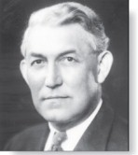
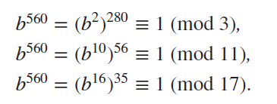
Carmichael Numbers (optional)
Robert Carmichael
(1879-1967)
There are composite integers n that pass all tests with bases b such that gcd(b,n) = 1.
Definition: A composite integer n that satisfies the congruence b^{n-1} ≡ 1 (mod n) for all positive integers b with gcd(b,n) = 1 is called a Carmichael number.
Example: The integer 561 is a Carmichael number. To see this:
561 is composite, since 561 = 3 ∙ 11 ∙ 13.
If gcd(b, 561) = 1, then gcd(b, 3) = 1, then gcd(b, 11) = gcd(b, 17) =1.
Using Fermat’s Little Theorem: b² ≡ 1 (mod 3), b¹⁰ ≡ 1 (mod 11), b¹⁶ ≡ 1 (mod 17).
Then
It follows that b⁵⁶⁰ ≡ 1 (mod 561) for all positive integers b with gcd(b,561) = 1. Hence, 561 is a Carmichael number.
Even though there are infinitely many Carmichael numbers, there are other tests that form the basis for efficient probabilistic primality testing.

Slide 78
Primitive Roots
Definition: A primitive root modulo a prime p is an integer r in Z_{p} such that every nonzero element of Z_{p} is a power of r.
Example: Since every element of Z₁₁ is a power of 2, 2 is a primitive root of 11.
Powers of 2 modulo 11: 2¹ = 2, 2² = 4, 2³ = 8, 2⁴ = 5, 2⁵ = 10, 2⁶ = 9, 2⁷ = 7, 2⁸ = 3, 2¹⁰ = 2.
Example: Since not all elements of Z₁₁ are powers of 3, 3 is not a primitive root of 11.
Powers of 3 modulo 11: 3¹ = 3, 3² = 9, 3³ = 5, 3⁴ = 4, 3⁵ = 1, and the pattern repeats for higher powers.
Important Fact: There is a primitive root modulo p for every prime number p.

Slide 79
Discrete Logarithms
Suppose p is prime and r is a primitive root modulo p. If a is an integer between 1 and p −1, that is an element of Z_{p}, there is a unique exponent e such that r^{e} = a in Z_{p}, that is, r^{e} mod p = a.
Definition: Suppose that p is prime, r is a primitive root modulo p, and a is an integer between 1 and p −1, inclusive. If r^{e} mod p = a and 1 ≤ e ≤ p − 1, we say that e is the discrete logarithm of a modulo p to the base r and we write log_{r} a = e (where the prime p is understood).
Example 1: We write log₂ 3 = 8 since the discrete logarithm of 3 modulo 11 to the base 2 is 8 as 2⁸ = 3 modulo 11.
Example 2: We write log₂ 5 = 4 since the discrete logarithm of 5 modulo 11 to the base 2 is 4 as 2⁴ = 5 modulo 11.
There is no known polynomial time algorithm for computing the discrete logarithm of a modulo p to the base r (when given the prime p, a root r modulo p, and a positive integer a ∊Z_{p}).

Slide 80
Applications of Congruences

Slide 81
Section Summary 5
Hashing Functions
Pseudorandom Numbers
Check Digits

Slide 82
Hashing Functions
Definition: A hashing function h assigns memory location h(k) to the record that has k as its key.
A common hashing function is h(k) = k mod m, where m is the number of memory locations.
Because this hashing function is onto, all memory locations are possible.
Example: Let h(k) = k mod 111. This hashing function assigns the records of customers with social security numbers as keys to memory locations in the following manner:
h(064212848) = 064212848 mod 111 = 14
h(037149212) = 037149212 mod 111 = 65
h(107405723) = 107405723 mod 111 = 14, but since location 14 is already occupied, the record is assigned to the next available position, which is 15.
The hashing function is not one-to-one as there are many more possible keys than memory locations. When more than one record is assigned to the same location, we say a collision occurs. Here a collision has been resolved by assigning the record to the first free location.
For collision resolution, we can use a linear probing function: h(k,i) = (h(k) + i) mod m, where i runs from 0 to m − 1.
There are many other methods of handling with collisions.

Slide 83
Pseudorandom Numbers 1
Randomly chosen numbers are needed for many purposes, including computer simulations.
Pseudorandom numbers are not truly random since they are generated by systematic methods.
The linear congruential method is one commonly used procedure for generating pseudorandom numbers.
Four integers are needed: the modulus m, the multiplier a, the increment c, and seed x₀, with 2 ≤ a < m, 0 ≤ c < m, 0 ≤ x₀ < m.
We generate a sequence of pseudorandom numbers {x_{n}}, with 0 ≤ x_{n} < m for all n, by successively using the recursively defined function
If psuedorandom numbers between 0 and 1 are needed, then the generated numbers are divided by the modulus, x_{n} /m.

Slide 84
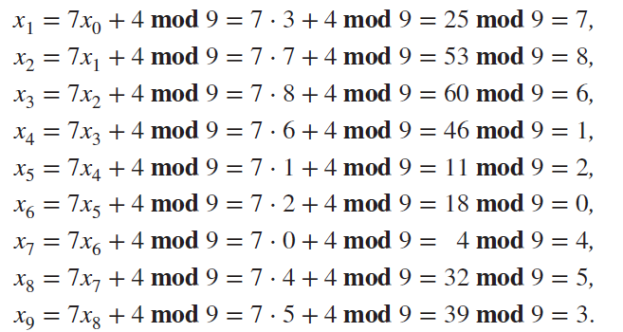
Pseudorandom Numbers 2
Example: Find the sequence of pseudorandom numbers generated by the linear congruential method with modulus m = 9, multiplier a = 7, increment c = 4, and seed x₀ = 3.
Solution: Compute the terms of the sequence by successively using the congruence
The sequence generated is 3,7,8,6,1,2,0,4,5,3,7,8,6,1,2,0,4,5,3,…
It repeats after generating 9 terms.
Commonly, computers use a linear congruential generator with increment c = 0. This is called a pure multiplicative generator. Such a generator with modulus 2³¹ − 1 and multiplier 7⁵ = 16,807 generates 2³¹ − 2 numbers before repeating.

Slide 85
Check Digits: UPCs
A common method of detecting errors in strings of digits is to add an extra digit at the end, which is evaluated using a function. If the final digit is not correct, then the string is assumed not to be correct.
Example: Retail products are identified by their Universal Product Codes (UPCs). Usually these have 12 decimal digits, the last one being the check digit. The check digit is determined by the congruence:
3x₁ + x₂ + 3x₃ + x₄ + 3x₅ + x₆ + 3x₇ + x₈ + 3x₉ + x₁₀ + 3x₁₁ + x₁₂ ≡ 0 (mod 10).
Suppose that the first 11 digits of the UPC are 79357343104. What is the check digit?
Is 041331021641 a valid UPC?
Solution:
3∙7 + 9 + 3∙3 + 5 + 3∙7 + 3 + 3∙4 + 3 + 3∙1 + 0 + 3∙4 + x₁₂ ≡ 0 (mod 10) 21 + 9 + 9 + 5 + 21 + 3 + 12+ 3 + 3 + 0 + 12 + x₁₂ ≡ 0 (mod 10) 98 + x₁₂ ≡ 0 (mod 10) x₁₂ ≡ 2 (mod 10) So, the check digit is 2.
3∙0 + 4 + 3∙1 + 3 + 3∙3 + 1 + 3∙0 + 2 + 3∙1 + 6 + 3∙4 + 1 ≡ 0 (mod 10) 0 + 4 + 3 + 3 + 9 + 1 + 0+ 2 + 3 + 6 + 12 + 1 = 44 ≡ 4 ≢ 0 (mod 10) Hence, 041331021641 is not a valid UPC.

Slide 86
Check Digits:ISBNs
Books are identified by an International Standard Book Number (ISBN-10), a 10 digit code. The first 9 digits identify the language, the publisher, and the book. The tenth digit is a check digit, which is determined by the following congruence
The validity of an ISBN-10 number can be evaluated with the equivalent
Suppose that the first 9 digits of the ISBN-10 are 007288008. What is the check digit?
Is 084930149X a valid ISBN10?
Solution:
X₁₀ ≡ 1∙0 + 2∙0 + 3∙7 + 4∙2 + 5∙8 + 6∙8 + 7∙ 0 + 8∙0 + 9∙8 (mod 11). X₁₀ ≡ 0 + 0 + 21 + 8 + 40 + 48 + 0 + 0 + 72 (mod 11). X₁₀ ≡ 189 ≡ 2 (mod 11). Hence, X₁₀ = 2.
1∙0 + 2∙8 + 3∙4 + 4∙9 + 5∙3 + 6∙0 + 7∙ 1 + 8∙4 + 9∙9 + 10∙10 = 0 + 16 + 12 + 36 + 15 + 0 + 7 + 32 + 81 + 100 = 299 ≡ 2 ≢ 0 (mod 11)
Hence, 084930149X is not a valid ISBN-10.
A single error is an error in one digit of an identification number and a transposition error is the accidental interchanging of two digits. Both of these kinds of errors can be detected by the check digit for ISBN-10.
X is used for the digit 10.

Slide 87
Cryptography

Slide 88
Section Summary 6
Classical Cryptography
Cryptosystems
Public Key Cryptography
RSA Cryptosystem
Cryptographic Protocols
Primitive Roots and Discrete Logarithms

Slide 89
Caesar Cipher 1
Julius Caesar created secret messages by shifting each letter three letters forward in the alphabet (sending the last three letters to the first three letters.) For example, the letter B is replaced by E and the letter X is replaced by A. This process of making a message secret is an example of encryption.
Here is how the encryption process works:
Replace each letter by an integer from Z₂₆, that is an integer from 0 to 25 representing one less than its position in the alphabet.
The encryption function is f(p) = (p + 3) mod 26. It replaces each integer p in the set {0,1,2,…,25} by f(p) in the set {0,1,2,…,25} .
Replace each integer p by the letter with the position p + 1 in the alphabet.
Example: Encrypt the message “MEET YOU IN THE PARK” using the Caesar cipher.
Solution: 12 4 4 19 24 14 20 8 13 19 7 4 15 0 17 10.
Now replace each of these numbers p by f(p) = (p + 3) mod 26.
15 7 7 22 1 17 23 11 16 22 10 7 18 3 20 13.
Translating the numbers back to letters produces the encrypted message
“PHHW BRX LQ WKH SDUN.”

Slide 90
Caesar Cipher 2
To recover the original message, use f⁻¹(p) = (p−3) mod 26. So, each letter in the coded message is shifted back three letters in the alphabet, with the first three letters sent to the last three letters. This process of recovering the original message from the encrypted message is called decryption.
The Caesar cipher is one of a family of ciphers called shift ciphers. Letters can be shifted by an integer k, with 3 being just one possibility. The encryption function is
f(p) = (p + k) mod 26
and the decryption function is
f⁻¹(p) = (p−k) mod 26
The integer k is called a key.

Slide 91
Shift Cipher 1
Example 1: Encrypt the message “STOP GLOBAL WARMING” using the shift cipher with k = 11.
Solution: Replace each letter with the corresponding element of Z₂₆.
18 19 14 15 6 11 14 1 0 11 22 0 17 12 8 13 6.
Apply the shift f(p) = (p + 11) mod 26, yielding
3 4 25 0 17 22 25 12 11 22 7 11 2 23 19 24 17.
Translating the numbers back to letters produces the ciphertext
“DEZA RWZMLW HLCXTYR.”

Slide 92
Shift Cipher 2
Example 2: Decrypt the message “LEWLYPLUJL PZ H NYLHA ALHJOLY” that was encrypted using the shift cipher with k = 7.
Solution: Replace each letter with the corresponding element of Z₂₆.
11 4 22 11 24 15 11 20 9 1 15 25 7 13 24 11 7 0 0 11 7 9 14 11 24.
Shift each of the numbers by −k = −7 modulo 26, yielding
4 23 15 4 17 8 4 13 2 4 8 18 0 6 17 4 0 19 19 4 0 2 7 4 17.
Translating the numbers back to letters produces the decrypted message
“EXPERIENCE IS A GREAT TEACHER.”

Slide 93
Affine Ciphers
Shift ciphers are a special case of affine ciphers which use functions of the form
f(p) = (ap + b) mod 26,
where a and b are integers, chosen so that f is a bijection.
The function is a bijection if and only if gcd(a,26) = 1.
Example: What letter replaces the letter K when the function f(p) = (7p + 3) mod 26 is used for encryption.
Solution: Since 10 represents K, f(10) = (7∙10 + 3) mod 26 =21, which is then replaced by V.
To decrypt a message encrypted by a shift cipher, the congruence c ≡ ap + b (mod 26) needs to be solved for p.
Subtract b from both sides to obtain c− b ≡ ap (mod 26).
Multiply both sides by the inverse of a modulo 26, which exists since gcd(a,26) = 1.
ā(c− b) ≡ āap (mod 26), which simplifies to ā(c− b) ≡ p (mod 26).
p ≡ ā(c− b) (mod 26) is used to determine p in Z₂₆.s

Slide 94
Cryptanalysis of Affine Ciphers
The process of recovering plaintext from ciphertext without knowledge both of the encryption method and the key is known as cryptanalysis or breaking codes.
An important tool for cryptanalyzing ciphertext produced with a affine ciphers is the relative frequencies of letters. The nine most common letters in the English texts are E 13%, T 9%, A 8%, O 8%, I 7%, N 7%, S 7%, H 6%, and R 6%.
To analyze ciphertext:
Find the frequency of the letters in the ciphertext.
Hypothesize that the most frequent letter is produced by encrypting E.
If the value of the shift from E to the most frequent letter is k, shift the ciphertext by −k and see if it makes sense.
If not, try T as a hypothesis and continue.
Example: We intercepted the message “ZNK KGXRE HOXJ MKZY ZNK CUXS” that we know was produced by a shift cipher. Let’s try to cryptanalyze.
Solution: The most common letter in the ciphertext is K. So perhaps the letters were shifted by 6 since this would then map E to K. Shifting the entire message by −6 gives us “THE EARLY BIRD GETS THE WORM.”

Slide 95
Block Ciphers 1
Ciphers that replace each letter of the alphabet by another letter are called character or monoalphabetic ciphers.
They are vulnerable to cryptanalysis based on letter frequency. Block ciphers avoid this problem, by replacing blocks of letters with other blocks of letters.
A simple type of block cipher is called the transposition cipher. The key is a permutation σ of the set {1,2,…,m}, where m is an integer, that is a one-to-one function from {1,2,…,m} to itself.
To encrypt a message, split the letters into blocks of size m, adding additional letters to fill out the final block. We encrypt p₁,p₂,…,p_{m} as c₁,c₂,…,c_{m} = p_{σ(1)},p_{σ(2)},…,p_{σ(m)}.
To decrypt the c₁,c₂,…,c_{m} transpose the letters using the inverse permutation σ⁻¹.

Slide 96
Block Ciphers 2
Example: Using the transposition cipher based on the permutation σ of the set {1,2,3,4} with σ(1) = 3, σ(2) = 1, σ(3) = 4, σ(4) = 2,
Encrypt the plaintext PIRATE ATTACK
Decrypt the ciphertext message SWUE TRAEOEHS, which was encrypted using the same cipher.
Solution:
Split into four blocks PIRA TEAT TACK. Apply the permutation σ giving IAPR ETTA AKTC.
σ⁻¹ : σ ⁻¹(1) = 2, σ ⁻¹(2) = 4, σ ⁻¹(3) = 1, σ ⁻¹(4) = 3.
Apply the permutation σ⁻¹ giving USEW ATER HOSE.
Split into words to obtain USE WATER HOSE.

Slide 97
Cryptosystems 1
Definition: A cryptosystem is a five-tuple (P,C,K,E,D), where
P is the set of plaintext strings,
C is the set of ciphertext strings,
K is the keyspace (set of all possible keys),
E is the set of encryption functions, and
D is the set of decryption functions.
The encryption function in E corresponding to the key k is denoted by E_{k} and the description function in D that decrypts cipher text encrypted using E_{k} is denoted by D_{k}. Therefore:
D_{k}(E_{k}(p)) = p, for all plaintext strings p.

Slide 98
Cryptosystems 2
Example: Describe the family of shift ciphers as a cryptosystem.
Solution: Assume the messages are strings consisting of elements in Z₂₆.
P is the set of strings of elements in Z₂₆,
C is the set of strings of elements in Z₂₆,
K = Z₂₆,
E consists of functions of the form E_{k} (p) = (p + k) mod 26 , and
D is the same as E where D_{k} (p) = (p − k) mod 26 .

Slide 99
Public Key Cryptography
All classical ciphers, including shift and affine ciphers, are private key cryptosystems. Knowing the encryption key allows one to quickly determine the decryption key.
All parties who wish to communicate using a private key cryptosystem must share the key and keep it a secret.
In public key cryptosystems, first invented in the 1970s, knowing how to encrypt a message does not help one to decrypt the message. Therefore, everyone can have a publicly known encryption key. The only key that needs to be kept secret is the decryption key.

Slide 100


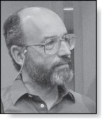

The RSA Cryptosystem
Clifford Cocks
(Born 1950)
A public key cryptosystem, now known as the RSA system was introduced in 1976 by three researchers at MIT.
Ronald Rivest
(Born 1948)
Adi Shamir
(Born 1952)
Leonard
Adelman
(Born 1945)
It is now known that the method was discovered earlier by Clifford Cocks, working secretly for the UK government.
The public encryption key is (n,e), where n = pq (the modulus) is the product of two large (200 digits) primes p and q, and an exponent e that is relatively prime to (p−1)(q −1). The two large primes can be quickly found using probabilistic primality tests, discussed earlier. But n = pq, with approximately 400 digits, cannot be factored in a reasonable length of time.

Slide 101
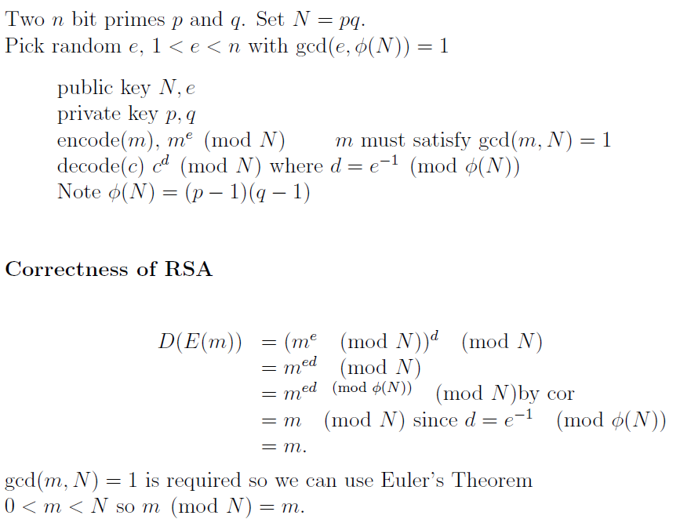
The RSA Cryptosystem

Slide 102
RSA加解密简单例子
公钥: (n,e)=(35, 5),其中n=pq=5*7, gcd(e, φ(35))=gcd(5, 24)=1;
私钥: (n,d)=(35, 5), 这里d=e⁻¹ mod φ(35)=5 [用扩展欧几里得算法可得]
取明文m=2, 这里gcd(m,n)=gcd(2,35)=1
则加密的密文 c=m^e mod n=2^5 mod 35=32;
解密：c^d mod n=32^5 mod 35=32²*32²*32 mod 35=9*9*32 mod 35=11*32 mod 35=
352 mod 35=2，和明文2一致.

Slide 103
RSA Encryption
To encrypt a message using RSA using a key (n,e) :
Translate the plaintext message M into sequences of two digit integers representing the letters. Use 00 for A, 01 for B, etc.
Concatenate the two digit integers into strings of digits.
Divide this string into equally sized blocks of 2N digits where 2N is the largest even number 2525…25 with 2N digits that does not exceed n.
The plaintext message M is now a sequence of integers m₁,m₂,…,m_{k}.
Each block (an integer) is encrypted using the function C = Me mod n.
Example: Encrypt the message STOP using the RSA cryptosystem with key(2537,13).
2537 = 43∙ 59,
p = 43 and q = 59 are primes and gcd(e,(p−1)(q −1)) = gcd(13, 42∙ 58) = 1.
Solution: Translate the letters in STOP to their numerical equivalents 18 19 14 15.
Divide into blocks of four digits (because 2525 < 2537 < 252525) to obtain 1819 1415.
Encrypt each block using the mapping C = M¹³ mod 2537.
Since 1819¹³ mod 2537 = 2081 and 1415¹³ mod 2537 = 2182, the encrypted message is 2081 2182.

Slide 104
RSA Decryption
To decrypt a RSA ciphertext message, the decryption key d, an inverse of e modulo (p−1)(q −1) is needed. The inverse exists since gcd(e,(p−1)(q −1)) = gcd(13, 42∙ 58) = 1.
With the decryption key d, we can decrypt each block with the computation M = C^{d} mod p∙q.
RSA works as a public key system since the only known method of finding d is based on a factorization of n into primes. There is currently no known feasible method for factoring large numbers into primes.
Example: The message 0981 0461 is received. What is the decrypted message if it was encrypted using the RSA cipher from the previous example.
Solution: The message was encrypted with n = 43∙ 59 and exponent 13. An inverse of 13 modulo 42∙ 58 = 2436 is d = 937.
To decrypt a block C, M = C⁹³⁷ mod 2537.
Since 0981⁹³⁷ mod 2537 = 0704 and 0461⁹³⁷ mod 2537 = 1115, the decrypted message is 0704 1115. Translating back to English letters, the message is HELP.

Slide 105
Cryptographic Protocols: Key Exchange
Cryptographic protocols are exchanges of messages carried out by two or more parties to achieve a particular security goal.
Key exchange is a protocol by which two parties can exchange a secret key over an insecure channel without having any past shared secret information. Here the Diffe-Hellman key agreement protocol is described by example.
Suppose that Alice and Bob want to share a common key.
Alice and Bob agree to use a prime p and a primitive root a of p.
Alice chooses a secret integer k₁ and sends a^{k1} mod p to Bob.
Bob chooses a secret integer k₂ and sends a^{k2} mod p to Alice.
Alice computes (a^{k2})^{k1} mod p.
Bob computes (a^{k1})^{k2} mod p.
At the end of the protocol, Alice and Bob have their shared key
(a^{k2})^{k1} mod p = (a^{k1})^{k2} mod p.
To find the secret information from the public information would require the adversary to find k₁ and k₂ from a^{k1} mod p and a^{k2} mod p respectively. This is an instance of the discrete logarithm problem, considered to be computationally infeasible when p and a are sufficiently large.

Slide 106
Diffie-Hellman密钥交换简单例子
步骤1：选择公共参数
Alice和Bob选择一个大质数p和一个原根g (模p), 这里设p=23,g=5;
步骤2：选择各自私钥
Alice和Bob各自秘密选择一个大的随机整数作为私钥. 假设Alice选择的私钥为a，Bob选择的私钥为b，这里设a=6, b=15.
步骤3：各自计算公钥
Alice计算她的公钥A，公式为：A = g^a mod p, 这里A=5^6 mod 23=8
Bob计算他的公钥B，公式为：B = g^b mod p,这里B=5^15 mod 23=19
Alice和Bob将他们的公钥发送给对方。
步骤4：各自计算共享密钥
Alice接收到Bob的公钥B后，计算共享密钥，公式为： B^a mod p, 这里公式为 19^6 mod 23=2
Bob接收到Alice的公钥A后，计算共享密钥，公式为： A^b mod p, 这里公式为8^15 mod 23=2
由于模运算的性质，Alice和Bob计算出的共享密钥是相同的。

Slide 107
Cryptographic Protocols: Digital Signatures 1
Adding a digital signature to a message is a way of ensuring the recipient that the message came from the purported sender.
Suppose that Alice’s RSA public key is (n,e) and her private key is d. Alice encrypts a plain text message x using E_{(n,e)} (x)= x^{d} mod n. She decrypts a ciphertext message y using D_{(n,e)} (y)= y^{d} mod n.
Alice wants to send a message M so that everyone who receives the message knows that it came from her.
She translates the message to numerical equivalents and splits into blocks, just as in RSA encryption.
She then applies her decryption function D_{(n,e)} to the blocks and sends the results to all intended recipients.
The recipients apply Alice’s encryption function and the result is the original plain text since E_{(n,e)} (D_{(n,e)} (x))= x.
Everyone who receives the message can then be certain that it came from Alice.

Slide 108
数字签名简单例子
这个例子不仅用了数字签名还用对方公钥进行加密：
设Alice和Bob利用RSA公钥密码体系进行通信，Alice的公钥: N_{A}=35, e_{A}=5；Bob的公钥N_{B}=33,e_{B}=3，可得Alice的私钥为(N_{A},d_{A})=(35,5)，Bob的私钥为(N_{B},d_{B})=(33,7)
Alice向Bob发送的明文4并加了其签名的密文为：
E_{B}(D_{A}(4))= E_{B}(4^5 mod 35)= E_{B}(9)=9^3 mod 33=729 mod 33=3;
Bob的解密过程为：
E_{A}(D_{B}(3))= E_{A}(3^7 mod 33)= E_{A}(9)=9^5 mod 35=81*81*9 mod 35=144 mod 35=4.

Slide 109
Cryptographic Protocols: Digital Signatures 2
Example: Suppose Alice’s RSA cryptosystem is the same as in the earlier example with key(2537,13), 2537 = 43∙ 59, p = 43 and q = 59 are primes and gcd(e,(p−1)(q −1)) = gcd(13, 42∙ 58) = 1.
Her decryption key is d = 937.
She wants to send the message “MEET AT NOON” to her friends so that they can be certain that the message is from her.
Solution: Alice translates the message into blocks of digits 1204 0419 0019 1314 1413.
She then applies her decryption transformation D_{(2537,13)} (x)= x⁹³⁷ mod 2537 to each block.
She finds (using her laptop, programming skills, and knowledge of discrete mathematics) that 1204⁹³⁷ mod 2537 = 817, 419⁹³⁷ mod 2537 = 555 , 19⁹³⁷ mod 2537 = 1310, 1314⁹³⁷ mod 2537 = 2173, and 1413⁹³⁷ mod 2537 = 1026.
She sends 0817 0555 1310 2173 1026.
When one of her friends receive the message, they apply Alice’s encryption transformation E_{(2537,13)} to each block. They then obtain the original message which they translate back to English letters.

Slide 110
同态加密(Homomorphic Encryption)
全同态加密(Fully Homomorphic Encryption)：在计算过程中，对密文不解密，能直接在密文上进行各种运算，直到最终需要计算结果时，再进行解密得到最终解，且该最终解和明文上经过这些运算后得到的解相同
简单例子：ENC((m₁+m₂)*m₃)= (ENC(m₁)+ENC(m₂))*ENC(m₃)
部分同态加密(Partially Homomorphic)：只对某个运算具有同态特性，譬如只允许在密文上进行加法，或只进行乘法操作
加法同态(Additively Homomorphic)：ENC(m₁+m₂)=(ENC(m₁)+ENC(m₂)
乘法同态(Multiplicatively Homomorphic)：ENC(m₁*m₂)= (ENC(m₁)*ENC(m₂)
RSA密码系统是乘法同态，而不是加法同态：
E_{(n,e)}(m₁)*E_{(n,e)}(m₂)=m₁e mod n * m₂e mod n=(m₁*m₂)^{e} mod n=E_{(n,e)}(m₁*m₂)

Slide 111
零知识证明(Zero Knowledge Proof)
零知识证明: 是一方（证明者Prover）向另一方（验证者Verifier）证明某命题的方法，特点是过程中除“该命题为真”之事外，不泄露任何信息。因此，可理解成“零泄密证明”.
零知识证明有三个关键属性：
完备性（Completeness）：若命题为真，则诚实（意即依协议行事）的证明者能说服诚实验证者
可靠性（Soundness）：若命题为假，则作弊证明者仅得极小机会能说服诚实验证者该事为真
零知识（Zero-Knowledge）：验证者不能从证明中获取任何超出该命题为真的信息。
证明者向验证者证明其知道离散对数，但验证者不能知道具体值(Schnorr零知识证明协议 )：
一个质数p和模p的原根g; 证明者有个小于p的私钥x,其公钥y=g^{x} mod p；接下来每轮的操作如下：
证明者随机选取一个小于p的整数r，并计算a= g^{r} mod p 发给验证者；
验证者发送一个随机选取的比特e(0或1)给证明者；
证明者计算并发送s=(r+ex) mod (p-1)给验证者；
验证者验证g^{s}=a*y^{e} mod p是否成立，如成立则验证者相信证明者知道离散对数x.
重复以上每轮操作n次
完备性：如果证明者确实知道x，则每次验证者的验证均成立；
可靠性：如证明者假装知道x，当e=0时，验证成立；当e=1时，因其不能求出x，验证不成立，因此作弊的证明者仅能以1/2的概率通过一轮验证，但重复足够多轮，成功作弊的概率可降到任意小.
但若e值不是随机，则证明者可成功作弊: e=0, 如常继续选r，计算a= g^{r} mod p 发给验证者, 验证者的验证总是成立；e=1，则随机取一个 r′ ，计算 a′ = g^{r ′} ⋅ ( g^{x} ) ⁻ ¹ mod p ，然后发送r′和 a′ 值予证明者(伪装成s和a); 此时验证者计算的值为 g^{r′} mod p ，等于 a′ ⋅ y，验证成立.
零知识：公钥y不会泄露x的值；s即(ex+r) mod (p-1)的值，可视为 x mod (p-1)的加密，若r确为随机，在0至(p-2)间均匀分布，则(ex+r) mod (p-1)也同样均匀分布，不会泄露任何关于x的信息.

Slide 112
如何处理大整数
如果一个整数超过64位，如何进行算术运算？
利用中国剩余定理（余数系统: Residue Number System），把大整数表示成一个tuple。

Slide 113
Residue Number Systems
Define a Residue Number System as follows
For any given integer x, x=(x₁|x₂|...|x_{k})RNS(P₁|P₂|...|P_{k})
where x_{i} = x mod P_{i} and ∀ i,j P_{i} is relatively prime to P_{j}
EX: 84 = (0|4|0)RNS(7|5|3) 1 = (1|1|1)RNS(7|5|3)
2 = (2|2|2)RNS(7|5|3)
3 = (3|3|0)RNS(7|5|3)
Residue numbers have unique representations mod
i.e. for (7|5|3) there are unique representations of 0-104.
右边6个数互质：

Slide 114
Residue Number Systems
Addition (subtraction is similar)
x+y = ((x₁+y₁)_{p1}| (x₂+y₂)_{p2}| ... | (x_{k}+y_{k})_{pk})RNS(P₁|P₂|...|P_{k})
where x_{i} = (x)_{pi} and y_{i} = (y)_{pi}
Multiplication
x*y = ((x₁*y₁)_{p1}| (x₂*y₂)_{p2}| ... | (x_{k}*y_{k})_{pk})RNS(P₁|P₂|...|P_{k})
where x_{i} = (x)_{pi} and y_{i} = (y)_{pi}

